Slide 1

MANAGEMENT OF INVENTORY SYSTEMS
Static Inventory Problems under Uncertainty
PROF PRADIP KUMAR RAY
DEPARTMENT OF INDUSTRIAL AND SYSTEMS ENGINEERING
IIT KHARAGPUR

Slide 2
Sub Topics
General Characteristics, Possible Decision Criteria, Wald Criterion, Savage Criterion
Bayes Criterion, Problem Formulation with Partial Information
Tchebycheff and Other Inequalities, Numerical Examples
Numerical Examples, Determination of order quantity when understock cost is estimated per unit basis
Important Points to note, Dynamic Inventory Problems under Uncertainty
PROF PRADIP KUMAR RAY
DEPARTMENT OF INDUSTRIAL AND SYSTEMS ENGINEERING
IIT KHARAGPUR

Slide 3
Static Inventory Problems under Uncertainty
General Characteristics
Possible Decision Criteria
Wald Criterion
Savage Criterion
PROF PRADIP KUMAR RAY
DEPARTMENT OF INDUSTRIAL AND SYSTEMS ENGINEERING
IIT KHARAGPUR

Slide 4
General Characteristics
Only one order is possible to be raised for meeting the demand of an item for a specific time period.
The demand levels of the inventory item under consideration are not known in the sense that probabilities of possible demand levels are not known.
If the inventory item is a new one and past data related to its demand are not available, the problem is of uncertain demand.
PROF PRADIP KUMAR RAY
DEPARTMENT OF INDUSTRIAL AND SYSTEMS ENGINEERING
IIT KHARAGPUR

Slide 5
General Characteristics
However, it is not the case of ‘no information’ about the demand level. If no information is available regarding demand level, no analysis is possible. We are not considering such an extreme case.
It is assumed that partial information about the demand in terms of say, mean, standard deviation, etc. is made available.
However, with the available information, no conclusions can be drawn about the distribution of demand.
PROF PRADIP KUMAR RAY
DEPARTMENT OF INDUSTRIAL AND SYSTEMS ENGINEERING
IIT KHARAGPUR

Slide 6
General Characteristics
Hence, the kind of analysis to be adopted for determination of order quantity (decision variable) is referred to as ‘distribution-free’ analysis.
This is a problem quite frequently occurring in the domain of inventory management.
We need to study a number of approaches, simple in nature, for solving this problem.
PROF PRADIP KUMAR RAY
DEPARTMENT OF INDUSTRIAL AND SYSTEMS ENGINEERING
IIT KHARAGPUR

Slide 7
Possible Decision Criteria
We are aware that in problems under risk, the demand probability distribution is known. However, here in this case, this distribution is not known, whatever may be the reason.
We need to solve the problem, even if the probability distribution of demand is not known.
Researchers, in the past, have suggested a solution of this problem based on selection of decision criteria.
PROF PRADIP KUMAR RAY
DEPARTMENT OF INDUSTRIAL AND SYSTEMS ENGINEERING
IIT KHARAGPUR

Slide 8
Possible Decision Criteria
There are three decision criteria recommended. You may select any one of these criteria for solving the problem.
The Decision Criteria are as follows:
(i) Minimax or Maximin criterion, proposed by Abraham Wald (Wald Criterion)
(ii) Regret criterion, proposed by Leonard Savage (Savage Criterion)
(iii)Equal probability criterion, proposed by Bayes and Laplace (Bayes Criterion)
PROF PRADIP KUMAR RAY
DEPARTMENT OF INDUSTRIAL AND SYSTEMS ENGINEERING
IIT KHARAGPUR

Slide 9
Wald Criterion: How to use?
First, create a ‘payoff matrix’ or ‘outcome matrix’ for the given problem (follow the procedure described in Week-3 lectures).
For each possible order strategy, select the ‘worst’ outcome or payoff. If the payoffs are in terms of ‘profit’, the worst is the minimum value. If the payoffs are in terms of ‘cost’, the worst is the maximum value.
PROF PRADIP KUMAR RAY
DEPARTMENT OF INDUSTRIAL AND SYSTEMS ENGINEERING
IIT KHARAGPUR

Slide 10
Wald Criterion: How to use?
We select that order strategy which has
maximum of such minimums, if payoffs are in terms of profit. This strategy is referred to as ‘Maximin’ strategy.
minimum of such maximums, if payoffs are in terms of cost. This strategy is referred to as ‘Minimax’ strategy.
PROF PRADIP KUMAR RAY
DEPARTMENT OF INDUSTRIAL AND SYSTEMS ENGINEERING
IIT KHARAGPUR

Slide 11
Example-1
Suppose, the payoff matrix (in terms of profit) is as follows:
Order | Demand
 | 1 | 2 | 3
1 | 3.50 | 3.50 | 3.50
2 | 2.00 | 7.00 | 7.00
3 | 0.50 | 5.50 | 10.50
PROF PRADIP KUMAR RAY
DEPARTMENT OF INDUSTRIAL AND SYSTEMS ENGINEERING
IIT KHARAGPUR

Slide 12
Solution
The ‘worst’ values for each order strategy are:
Order | Minimum payoff
1 | 3.50
2 | 2.00
3 | 0.50
Hence, maximum value of the ‘minimum’ or ‘worst’ values is 3.50 and order quantity is 1.
PROF PRADIP KUMAR RAY
DEPARTMENT OF INDUSTRIAL AND SYSTEMS ENGINEERING
IIT KHARAGPUR

Slide 13
Savage Criterion: How to use?
With respect to the ‘payoff’ matrix created for the given problem, calculate the ‘regrets’ or ‘opportunity costs’ under all possible demand levels for a particular order strategy or quantity.
When ‘regrets’ are computed for each possible order strategy, a ‘regret’ matrix, in terms of the opportunity costs, is formed for the given problem.
Apply ‘minimax’ criterion to regret matrix to get solution (order quantity).
PROF PRADIP KUMAR RAY
DEPARTMENT OF INDUSTRIAL AND SYSTEMS ENGINEERING
IIT KHARAGPUR

Slide 14
Example-2
Suppose, the payoff matrix (in terms of profit) in as follows:
Order | Demand
 | 1 | 2 | 3
1 | 3.50 | 3.50 | 3.50
2 | 2.00 | 7.00 | 7.00
3 | 0.50 | 5.50 | 10.50
PROF PRADIP KUMAR RAY
DEPARTMENT OF INDUSTRIAL AND SYSTEMS ENGINEERING
IIT KHARAGPUR

Slide 15
Solution
The regret matrix is as follows:
Order | Demand
 | 1 | 2 | 3
1 | 0 | 3.50 | 7.00
2 | 1.50 | 0 | 3.50
3 | 3.00 | 1.50 | 0
PROF PRADIP KUMAR RAY
DEPARTMENT OF INDUSTRIAL AND SYSTEMS ENGINEERING
IIT KHARAGPUR

Slide 16
Solution
Applying ‘minimax’ criterion, the result is as follows:
Order | Maximum regret
1 | 7.00
2 | 3.50
3 | 3.00
Hence, the solution is minimum among the maximums i.e. 3 units (order quantity).
PROF PRADIP KUMAR RAY
DEPARTMENT OF INDUSTRIAL AND SYSTEMS ENGINEERING
IIT KHARAGPUR

Slide 17
Solution
From the regret or opportunity cost matrix, we have two important information: (i) Unit overstock cost, and (ii) Unit understock cost.
For the given regret or opportunity cost matrix, we get:
Unit overstock cost = 1.5, and
Unit understock cost = 3.5
PROF PRADIP KUMAR RAY
DEPARTMENT OF INDUSTRIAL AND SYSTEMS ENGINEERING
IIT KHARAGPUR

Slide 18
Static Inventory Problems under Uncertainty
Bayes Criterion
Problem Formulation with Partial Information
PROF PRADIP KUMAR RAY
DEPARTMENT OF INDUSTRIAL AND SYSTEMS ENGINEERING
IIT KHARAGPUR

Slide 19
Bayes Criterion: How to use?
In this approach, we assume equal probability for all the possible demand levels. For example, if there are four possible demand level, (1, 2, 3, and 4), the probability of each demand level is assumed to be 0.25.
The basic assumption is:
when probability of a demand level is not known, we may assume that each demand level occurs with same or equal probability.
When probability value is assigned to each demand level, the problem under uncertainty is converted into problem under risk.
PROF PRADIP KUMAR RAY
DEPARTMENT OF INDUSTRIAL AND SYSTEMS ENGINEERING
IIT KHARAGPUR

Slide 20
Example-1
For the given payoff matrix,
Order | Demand
 | 1 | 2 | 3
1 | 3.50 | 3.50 | 3.50
2 | 2.00 | 7.00 | 7.00
3 | 0.50 | 5.50 | 10.50
PROF PRADIP KUMAR RAY
DEPARTMENT OF INDUSTRIAL AND SYSTEMS ENGINEERING
IIT KHARAGPUR

Slide 21
Solution
Probability for each demand level is assumed to be 1/3 or 0.33.
Calculate expected payoff for each order strategy:
Order-1: 3.50 × 1/3 + 3.50 × 1/3 + 3.50 × 1/3 = 3.50
Order-2: 2.00 × 1/3 + 7.00 × 1/3 + 7.00 × 1/3 = 5.33
Order-3: 0.50 × 1/3 + 5.50 × 1/3 + 10.50 × 1/3 = 5.50
Hence, order strategy is to order for 3 units.
PROF PRADIP KUMAR RAY
DEPARTMENT OF INDUSTRIAL AND SYSTEMS ENGINEERING
IIT KHARAGPUR

Slide 22
Problem Formulation with partial information
As has been stated earlier, in the majority of the cases, information is made available about the characteristics of demand, such as mean and standard deviation of demand.
However, with this set of information, it is not possible to conclude about the distribution of demand.
The question is: to what extent we can make use of this partial information to determine the order quantity?
In the context, the types of information that we may have as we start getting data on various characteristics of the demand are worth mentioning.
PROF PRADIP KUMAR RAY
DEPARTMENT OF INDUSTRIAL AND SYSTEMS ENGINEERING
IIT KHARAGPUR

Slide 23
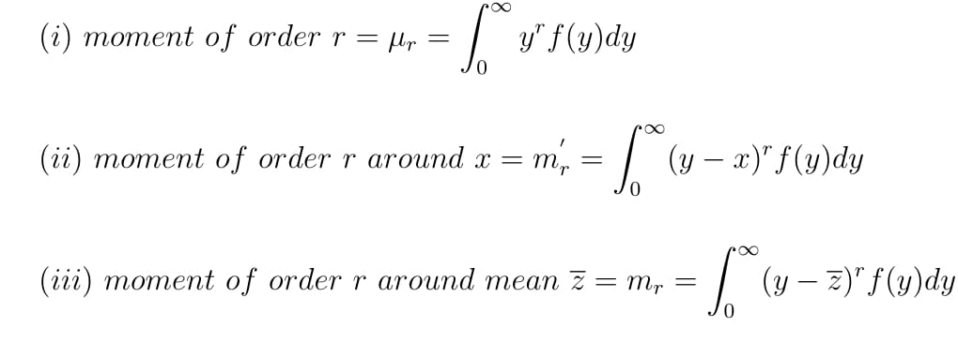
Partial Information
Partial information may be expressed in terms of moments of the demand distribution. In a given situation, we may know only some of the moments.
The following moments are relevant in this context:
PROF PRADIP KUMAR RAY
DEPARTMENT OF INDUSTRIAL AND SYSTEMS ENGINEERING
IIT KHARAGPUR

Slide 24
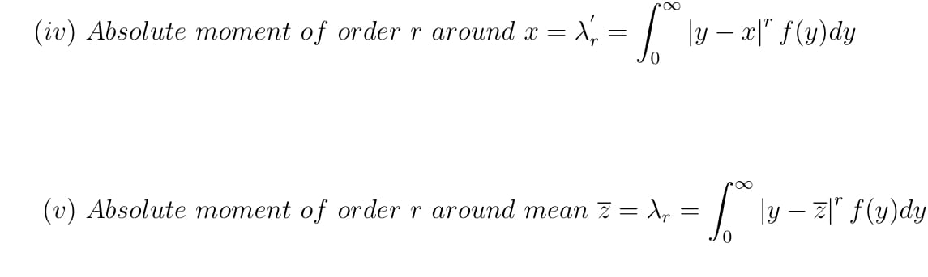
Partial Information
PROF PRADIP KUMAR RAY
DEPARTMENT OF INDUSTRIAL AND SYSTEMS ENGINEERING
IIT KHARAGPUR

Slide 25
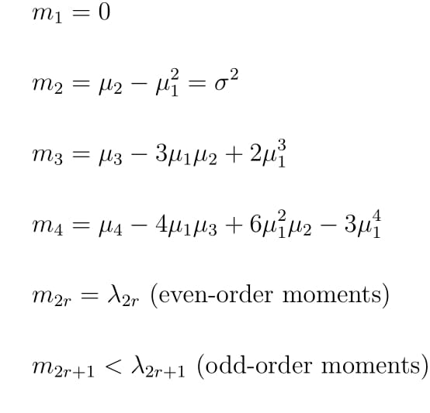
Partial Information
We have the following relationships
PROF PRADIP KUMAR RAY
DEPARTMENT OF INDUSTRIAL AND SYSTEMS ENGINEERING
IIT KHARAGPUR

Slide 26
Partial Information
We have the following relationships
PROF PRADIP KUMAR RAY
DEPARTMENT OF INDUSTRIAL AND SYSTEMS ENGINEERING
IIT KHARAGPUR

Slide 27
Partial Information
In a given running situation, information up to 3rd and 4th moments about the mean is quite common and made available.
With this information, the characteristics like skewness $γ_{1}$ and kurtosis$γ_{2}$ of a distribution can be measured. These measures are given by
$$γ_{1}=\frac{m_{3}}{σ^{2}}$$
and
$γ_{2}=\frac{m_{4}}{σ^{4}}$ - 3
PROF PRADIP KUMAR RAY
DEPARTMENT OF INDUSTRIAL AND SYSTEMS ENGINEERING
IIT KHARAGPUR

Slide 28
Partial Information
The expression for absolute moment about the mean has a special relevance in this case. When we do not know distribution type of the demand, we can use certain expressions derived in probability theory applicable for any type of distribution.
The inequality of probability theory, known as Tchebycheff’s inequality, we can use for problem formulation, and this inequality expression resembles closely with the expression for absolute moment of distribution around its mean.
PROF PRADIP KUMAR RAY
DEPARTMENT OF INDUSTRIAL AND SYSTEMS ENGINEERING
IIT KHARAGPUR

Slide 29
Static Inventory Problems under Uncertainty
Tchebycheff and Other Inequalities
Numerical Examples
PROF PRADIP KUMAR RAY
DEPARTMENT OF INDUSTRIAL AND SYSTEMS ENGINEERING
IIT KHARAGPUR

Slide 30
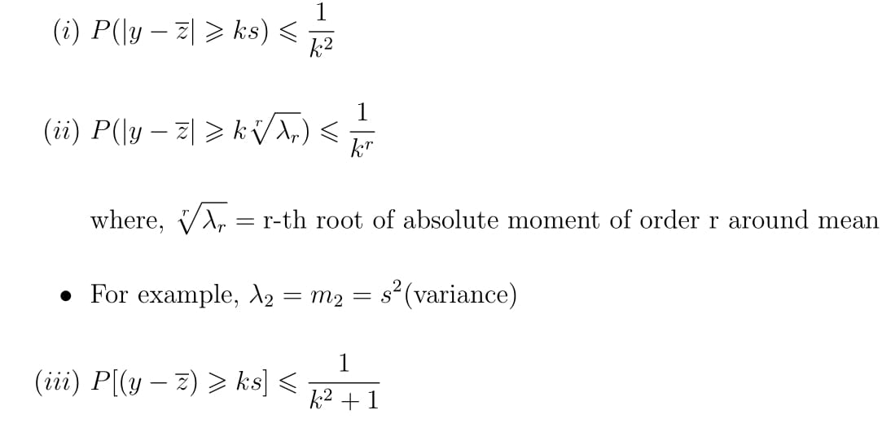
Tchebycheff and other Inequalities
Tchebycheff inequality expression is available in different forms. Some of the useful forms that we can use for problem formulation are as follows:
where,
$y$ = random variable (demand in this case)
$\overline{z}$ = mean of demand distribution
$s$ = standard deviation of demand distribution
$k$ = multiplying factor
PROF PRADIP KUMAR RAY
DEPARTMENT OF INDUSTRIAL AND SYSTEMS ENGINEERING
IIT KHARAGPUR

Slide 31
Tchebycheff and other Inequalities
This inequality you may use when information upto standard deviation is made available.
Here, deviation from mean is on one direction only.
PROF PRADIP KUMAR RAY
DEPARTMENT OF INDUSTRIAL AND SYSTEMS ENGINEERING
IIT KHARAGPUR

Slide 32
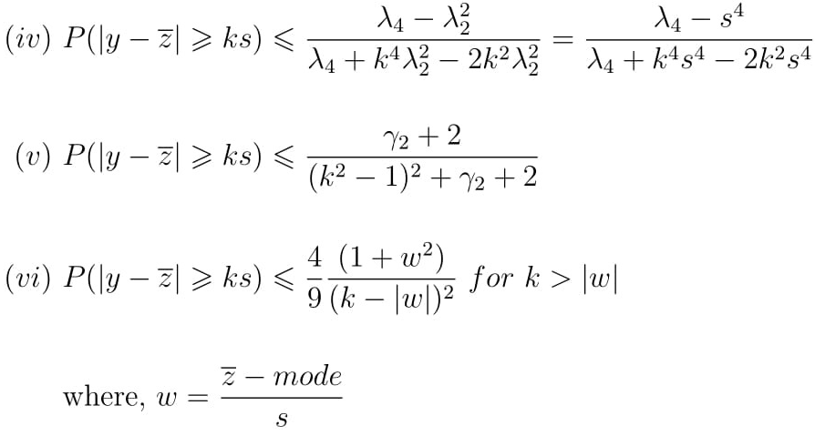
Tchebycheff and other Inequalities
PROF PRADIP KUMAR RAY
DEPARTMENT OF INDUSTRIAL AND SYSTEMS ENGINEERING
IIT KHARAGPUR

Slide 33
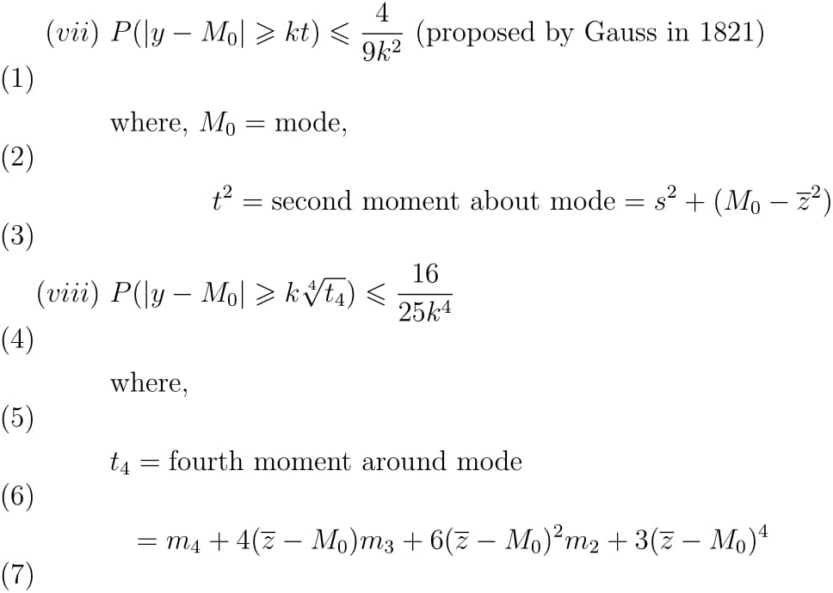
Tchebycheff and other Inequalities
PROF PRADIP KUMAR RAY
DEPARTMENT OF INDUSTRIAL AND SYSTEMS ENGINEERING
IIT KHARAGPUR

Slide 34
Tchebycheff and other Inequalities
PROF PRADIP KUMAR RAY
DEPARTMENT OF INDUSTRIAL AND SYSTEMS ENGINEERING
IIT KHARAGPUR

Slide 35
Tchebycheff and other Inequalities
Depending on the kinds of data made available, a particular inequality expression can be used for problem formulation.
A number of illustrative examples will be presented now. You will come to know the usefulness of these inequality expressions.
One important point: With the use of these inequalities, the solution you get is not the best one, but a ‘satisficing’ one. As of now, the distribution of the demand is not known and the solution of the problem is overdue – a typical situation with respect to many inventory items.
PROF PRADIP KUMAR RAY
DEPARTMENT OF INDUSTRIAL AND SYSTEMS ENGINEERING
IIT KHARAGPUR

Slide 36
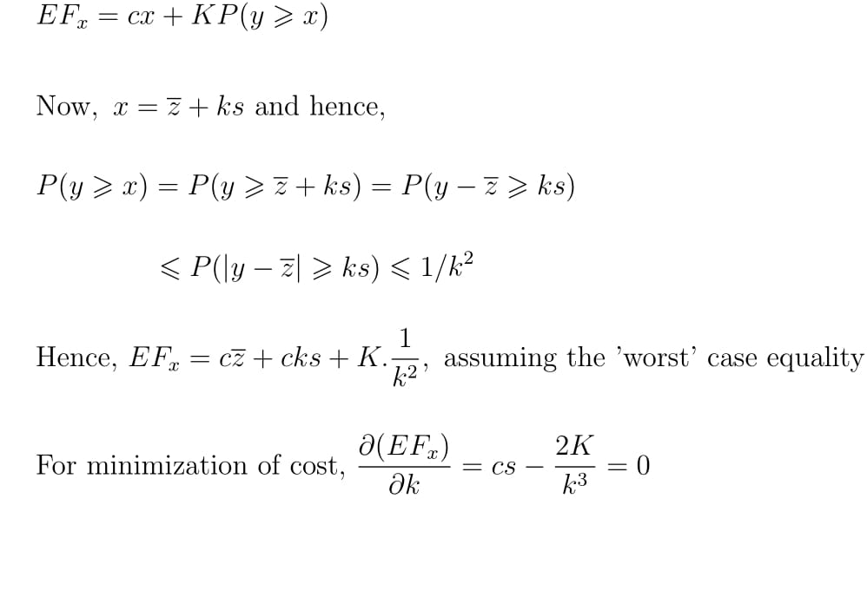
Example-1
If $c=$ cost of one unit, and $K=$fixed understock cost, determine the order quantity, $x$ using the inequality expression $(i)$
With respect to $x$, the expected total cost, ${EF}_{x}$ is given by
PROF PRADIP KUMAR RAY
DEPARTMENT OF INDUSTRIAL AND SYSTEMS ENGINEERING
IIT KHARAGPUR

Slide 37

Example-1
assuming the ‘worst’ case equality
or,
PROF PRADIP KUMAR RAY
DEPARTMENT OF INDUSTRIAL AND SYSTEMS ENGINEERING
IIT KHARAGPUR

Slide 38
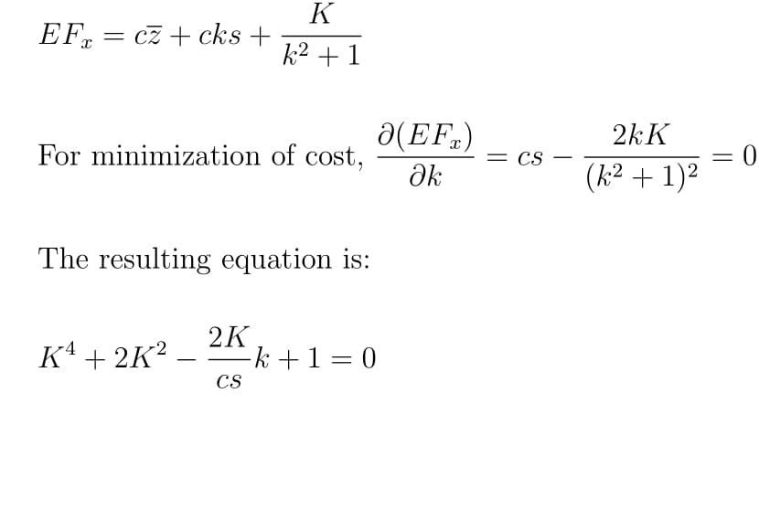
Example-1
If $\overline{z}$ = 50, $s=$5, $c$ = 5, and $K$ = 1,000,
$k=\sqrt[3]{\frac{2×1000}{5×5}}$ = 4.31
and $x=50+4.31×5=71.55≈72$
If we use the inequality expression (iii), we get
PROF PRADIP KUMAR RAY
DEPARTMENT OF INDUSTRIAL AND SYSTEMS ENGINEERING
IIT KHARAGPUR

Slide 39

Example-1
Solving the equation for $k$, we get $k$ = 4.15, and
hence, $x=$ 50 + 4.15 × 5 = 70.75 $≈$ 71
For both the above cases, we have followed ‘minimax’ criterion (over probability distributions).
PROF PRADIP KUMAR RAY
DEPARTMENT OF INDUSTRIAL AND SYSTEMS ENGINEERING
IIT KHARAGPUR

Slide 40
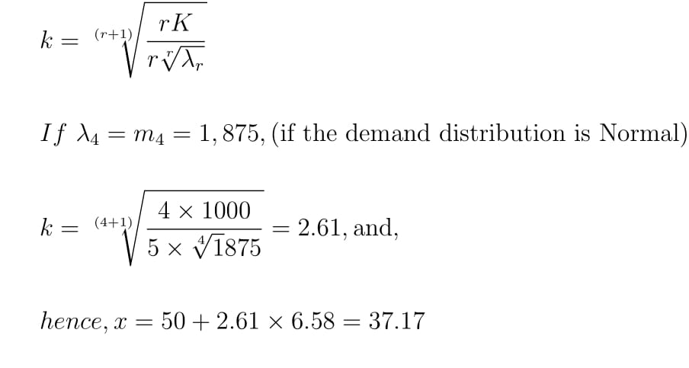

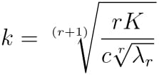
Example-2
In case we use the inequality in most general form given by (ii), the expected cost equation is given by
With cost minimization, the optimal value of $k$ is given by
PROF PRADIP KUMAR RAY
DEPARTMENT OF INDUSTRIAL AND SYSTEMS ENGINEERING
IIT KHARAGPUR

Slide 41
Example-2
hence,
$$x=50+2.61×6.58=67.17$$
PROF PRADIP KUMAR RAY
DEPARTMENT OF INDUSTRIAL AND SYSTEMS ENGINEERING
IIT KHARAGPUR

Slide 42
Static Inventory Problems under Uncertainty
Numerical Examples
Determination of order quantity when understock cost is estimated per unit basis
PROF PRADIP KUMAR RAY
DEPARTMENT OF INDUSTRIAL AND SYSTEMS ENGINEERING
IIT KHARAGPUR

Slide 43
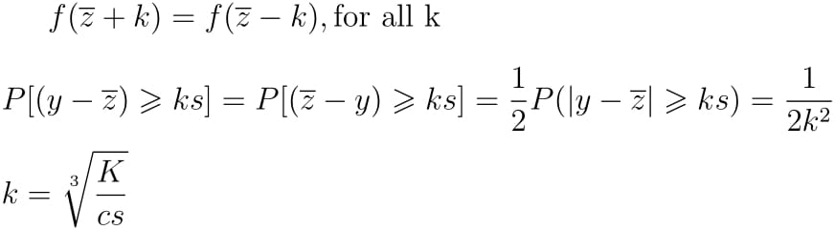

Example-3
Suppose, we conclude that the distribution is symmetrical. How to incorporate this information in making the decision (determination of order quantity)?
Assumption of symmetry means, for any demand distribution,
Under this condition, the inequality changes to
PROF PRADIP KUMAR RAY
DEPARTMENT OF INDUSTRIAL AND SYSTEMS ENGINEERING
IIT KHARAGPUR

Slide 44
Example-3
For the previous cost equation, with incorporation of this change in the upper limit, the optimal value of $k$ is given by
With previous set of data, $k$ = 3.42 and hence, the order quantity is determined as
$$x=50+5×3.42=67.1$$
PROF PRADIP KUMAR RAY
DEPARTMENT OF INDUSTRIAL AND SYSTEMS ENGINEERING
IIT KHARAGPUR

Slide 45
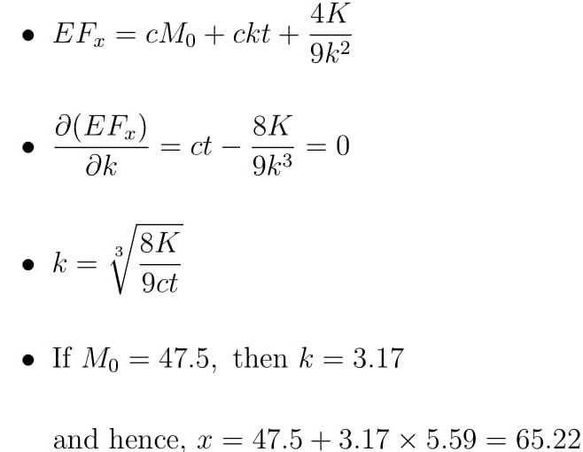
Example-4
Using the Gauss inequalities ($\left(vii\right)$ and $\left(viii\right)$), how to determine the order quantity?
PROF PRADIP KUMAR RAY
DEPARTMENT OF INDUSTRIAL AND SYSTEMS ENGINEERING
IIT KHARAGPUR

Slide 46
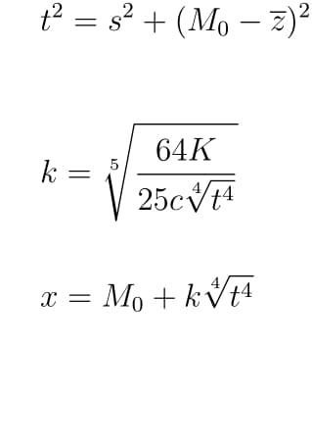
Example-4
You need to determine $t$ using the equation:
If we use inequality $\left(viii\right)$, the optimal value of $k$ is given by
If $m_{2}$ = 25, $m_{3}$ = 125, $m_{4}$ = 2,000, $M_{0}$ = 47.5, $\overline{z}$ = 50, $t_{4}$ = 4,227, and $k$ = 2.29
The optimal order quantity is $x$ = 66.00
PROF PRADIP KUMAR RAY
DEPARTMENT OF INDUSTRIAL AND SYSTEMS ENGINEERING
IIT KHARAGPUR

Slide 47
Determination of order quantity when understock cost is estimated per unit basis
In all the previous cases, we assume that understock cost remains fixed or constant irrespective of the number or amount of shortages.
In many cases of inventory management, the understock cost is estimated per unit basis, that means, understock cost varies proportionately with the number of units in shortage.
PROF PRADIP KUMAR RAY
DEPARTMENT OF INDUSTRIAL AND SYSTEMS ENGINEERING
IIT KHARAGPUR

Slide 48
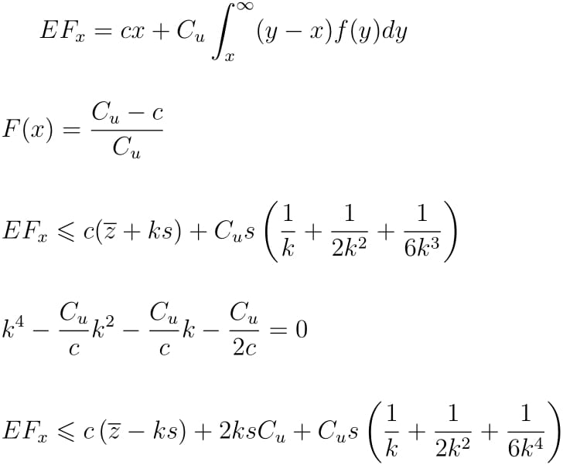
Determination of order quantity when understock cost is estimated per unit basis
Assuming $C_{u}$ = understock cost per unit, the total cost expression with $x$ ordering quantity, for the given inventory item is given by
The cost is minimized when
PROF PRADIP KUMAR RAY
DEPARTMENT OF INDUSTRIAL AND SYSTEMS ENGINEERING
IIT KHARAGPUR

Slide 49
Determination of order quantity when understock cost is estimated per unit basis
We want to find a solution with a distribution-free method of analysis. A set of Tchebycheff inequality expressions we can use in this case under different assumptions.
Using one particular inequality expression, we get the following expression for the expected cost:
PROF PRADIP KUMAR RAY
DEPARTMENT OF INDUSTRIAL AND SYSTEMS ENGINEERING
IIT KHARAGPUR

Slide 50
Determination of order quantity when understock cost is estimated per unit basis
The optimal value of $k$ is determined by solving the following equation (obtained by differentiating the above expression of ${EF}_{x}$),
If $\overline{z}$= 50, $s$ = 5, $c$ = 5, and $C_{u}$= 50, we find $k$= 3.62
and $x=50+5×3.62=68.1,$
assuming the order size is greater than mean
PROF PRADIP KUMAR RAY
DEPARTMENT OF INDUSTRIAL AND SYSTEMS ENGINEERING
IIT KHARAGPUR

Slide 51
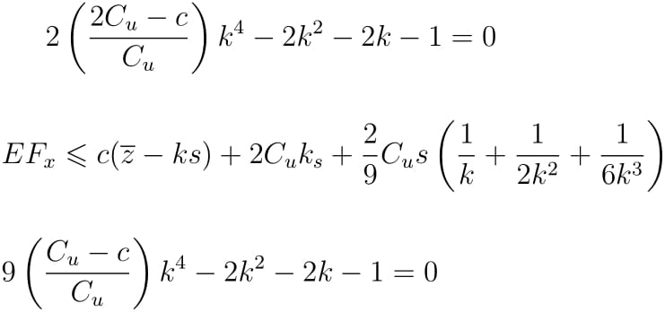
Determination of order quantity when understock cost is estimated per unit basis
If order size $x$ is assumed to be less than mean $\overline{z}$, the following expression for ${EF}_{x}$ is obtained based on Tchebycheff inequality:
The optimal value of $k$ is given by the positive root of the equation,
PROF PRADIP KUMAR RAY
DEPARTMENT OF INDUSTRIAL AND SYSTEMS ENGINEERING
IIT KHARAGPUR

Slide 52
Determination of order quantity when understock cost is estimated per unit basis
If $\overline{z}$ = 50, $s$ = 5, $c$ = 40, and $C_{u}$ = 50,
$k$ = 1.31 and $x=43.45$
If the demand distribution is assumed to be symmetrical and unimodal, the cost equation is given by
PROF PRADIP KUMAR RAY
DEPARTMENT OF INDUSTRIAL AND SYSTEMS ENGINEERING
IIT KHARAGPUR

Slide 53
Determination of order quantity when understock cost is estimated per unit basis
Minimization of cost results in the following equation for $k$:
With the previous data, we find that $k$ = 1.46 and $x=42.7$
PROF PRADIP KUMAR RAY
DEPARTMENT OF INDUSTRIAL AND SYSTEMS ENGINEERING
IIT KHARAGPUR

Slide 54
Static Inventory Problems under Uncertainty
Important points to note
Dynamic Inventory Problems under Uncertainty
PROF PRADIP KUMAR RAY
DEPARTMENT OF INDUSTRIAL AND SYSTEMS ENGINEERING
IIT KHARAGPUR

Slide 55
Important points to note
We need to study the problem in depth and the kinds of data related to demand distribution made available.
Depending on the type of data available and knowledge about the characteristics of demand distribution (like, if the distribution is symmetrical, the distribution is unimodal, etc), a particular inequality expression is to be selected in developing the relevant cost equation in terms of the decision variable (order quantity for the given inventory item).
PROF PRADIP KUMAR RAY
DEPARTMENT OF INDUSTRIAL AND SYSTEMS ENGINEERING
IIT KHARAGPUR

Slide 56
Important points to note
As we add more information about the demand distribution, better and improved solution for the decision variable is obtained.
When we encounter dynamic inventory problem under uncertainty, the kinds of methods and inequalities as we discuss here can be used with certain obvious changes.
The methods employed for solving static inventory problems under uncertainty can be extended for dynamic inventory problems, with certain changes.
PROF PRADIP KUMAR RAY
DEPARTMENT OF INDUSTRIAL AND SYSTEMS ENGINEERING
IIT KHARAGPUR

Slide 57
Dynamic Inventory Problem under Uncertainty
As dynamic inventory problems deal with ordering in multiple time periods (more than one order), we need to consider convolution of the demand distribution for more than one period, say n time periods.
However, in this case, as the demand distribution is not known, the convolution of demand distribution cannot be computed. With respect to the moments of the distribution, the convolution can be computed.
PROF PRADIP KUMAR RAY
DEPARTMENT OF INDUSTRIAL AND SYSTEMS ENGINEERING
IIT KHARAGPUR

Slide 58
Dynamic Inventory Problem under Uncertainty
Let the moments of the basic distribution are: $\overline{z}$, $s^{2}$, $m_{3}$, and $m_{4}$ and skewness and kurtosis are $γ_{1}$ and $γ_{2}$, respectively.
The moments of i-thconvolution are as follows:
While using a particular inequality expression for a given problem, we need to consider convoluted moments and measures in the inequality expression.
PROF PRADIP KUMAR RAY
DEPARTMENT OF INDUSTRIAL AND SYSTEMS ENGINEERING
IIT KHARAGPUR

Slide 59
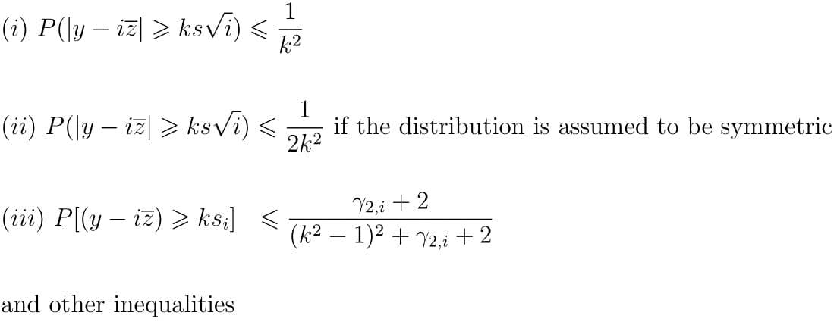
Dynamic Inventory Problem under Uncertainty
For example, we may use the following inequality expressions:
PROF PRADIP KUMAR RAY
DEPARTMENT OF INDUSTRIAL AND SYSTEMS ENGINEERING
IIT KHARAGPUR

Slide 60
Dynamic Inventory Problem under Uncertainty
While determining the order quantity and safety stock/reorder points in Q-system of inventory control or the maximum inventory and order period in P-system of inventory control, we need to minimize the total relevant cost in both appropriate and exact methods.
While developing the total cost expression, we need to use one of the relevant inequalities depending on the assumptions considered valid on understock cost (fixed or per unit).
Details of the methods to be used in this context (for both Q- and P-system) will be discussed in later weeks with numerical exercises.
PROF PRADIP KUMAR RAY
DEPARTMENT OF INDUSTRIAL AND SYSTEMS ENGINEERING
IIT KHARAGPUR

Slide 61
Dynamic Inventory Problem under Uncertainty
While dealing with Q-system of inventory control, there may be occasions/situations where out-of-stock cost may be difficult to measure.
There may be three ways this problem can be addressed:
Performance standard set by management
Fixed out-of-stock cost regardless of the number of units short
Per unit out-of-stock cost
PROF PRADIP KUMAR RAY
DEPARTMENT OF INDUSTRIAL AND SYSTEMS ENGINEERING
IIT KHARAGPUR

Slide 62
Dynamic Inventory Problem under Uncertainty
First Approach: Performance standard set
Let us assume, in respect of demand per week, mean = 50, standard deviation = 5, lead time = 3 weeks.
The Tchebycheff inequality in this case is given by
$$P(y−150≥8.66k)≤\frac{1}{k^{2}}$$
Let us assume that there is not an out-of-stock more than one time in a thousand lead time periods. Hence,
$\frac{1}{k^{2}}$= 0.001 or k = 31.62
PROF PRADIP KUMAR RAY
DEPARTMENT OF INDUSTRIAL AND SYSTEMS ENGINEERING
IIT KHARAGPUR

Slide 63

Dynamic Inventory Problem under Uncertainty
Safety Stock = 8.66 × 31.62 = 273.8 units
If the demand distribution is assumed to be symmetrical,
$\frac{1}{{2k}^{2}}$ = 0.001 or k = 22.36 and hence, safety stock = 8.66 × 22.36 = 193.6
With the addition of more information like kurtosis $γ_{2}$= 0, we may use the inequality
As $γ_{2}$= 0, $γ_{2,i}$= 0, we get k = 6.76 and the safety stock is 8.66 × 6.76 = 58.5
PROF PRADIP KUMAR RAY
DEPARTMENT OF INDUSTRIAL AND SYSTEMS ENGINEERING
IIT KHARAGPUR

Slide 64
Dynamic Inventory Problem under Uncertainty
As has been observed, with the addition of more information regarding distribution of demand, more accurate the result becomes.
Second Approach: Fixed out-of-stock cost assumed.
In approximate analysis, the total cost equation TCr, in relation to the safety stock, r is given by
${TC}_{r}=riC_{u}$ + $\frac{52}{t}KP\left(y>r\right)$
$≤ks_{j}iC_{u}$ + $\frac{52}{t}$ K $\frac{1}{k^{2}}$(j = time period for which the safety stock is
determined)
PROF PRADIP KUMAR RAY
DEPARTMENT OF INDUSTRIAL AND SYSTEMS ENGINEERING
IIT KHARAGPUR

Slide 65
Dynamic Inventory Problem under Uncertainty
Assuming equation of TCrhaving the minimum possible cost, we get the optimal value of k as
$\frac{d{TC}_{r}}{dk}$ = $s_{j }iC_{u }− \frac{104K}{tk^{3}}$ = 0
or, k = $\sqrt[3]{\frac{104K}{ts_{j }iC_{u }}}$
For example, If K = 1000, k = 15, using previous values of other parameters, the corresponding value of safety stock = 129.9
PROF PRADIP KUMAR RAY
DEPARTMENT OF INDUSTRIAL AND SYSTEMS ENGINEERING
IIT KHARAGPUR

Slide 66

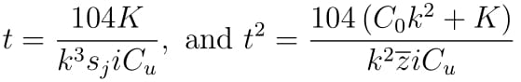
Dynamic Inventory Problem under Uncertainty
As we use other inequality expressions with the addition other information about the demand distribution, we get more accurate value for the safety stock.
For getting the exact solution, we form the total cost expression using Tchebycheff inequality in terms of both the decision variables (t and k) as
Setting partial derivatives with respect to t and k to zero and solving the resulting simultaneous equations, we get
PROF PRADIP KUMAR RAY
DEPARTMENT OF INDUSTRIAL AND SYSTEMS ENGINEERING
IIT KHARAGPUR

Slide 67
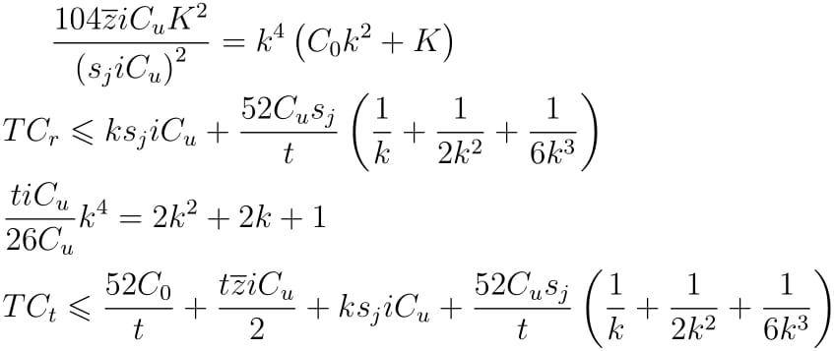
Dynamic Inventory Problem under Uncertainty
Equating expression of t, we get
The above equation can be solved for any specified set of values for the order quantities.
For K = 1000, k = 14.4, t = 7.23. Hence, order quantity is 7.23 × 50 = 361.5 and safety stock = 121.6
PROF PRADIP KUMAR RAY
DEPARTMENT OF INDUSTRIAL AND SYSTEMS ENGINEERING
IIT KHARAGPUR

Slide 68
Dynamic Inventory Problem under Uncertainty
Third Approach : per unit out-of-stock cost
As an approximate analysis, we can use the following equation for determination of safety stock:
PROF PRADIP KUMAR RAY
DEPARTMENT OF INDUSTRIAL AND SYSTEMS ENGINEERING
IIT KHARAGPUR

Slide 69
Dynamic Inventory Problem under Uncertainty
As an exact analysis, we can use the following equation for determination of optimal order point and safety stock:
There may be other inequality expressions that may be used as more information regarding demand probability distribution is made available with adequate information system support.
PROF PRADIP KUMAR RAY
DEPARTMENT OF INDUSTRIAL AND SYSTEMS ENGINEERING
IIT KHARAGPUR

Slide 70
List of Reference Textbooks
Starr, M K and Miller, D W, Inventory Control: Theory and Practice, Prentice Hall.
Tersine, R J, Principles of Inventory and Materials Management, PTR Prentice Hall.
Silver, E A, Pyke, D F and Peterson, R, Inventory Management and Production Planning and Scheduling, John Wiley.
Prof Pradip Kumar Ray
Department of Industrial and Systems Engineering

Slide 71
Thank You!!

